Slide 1
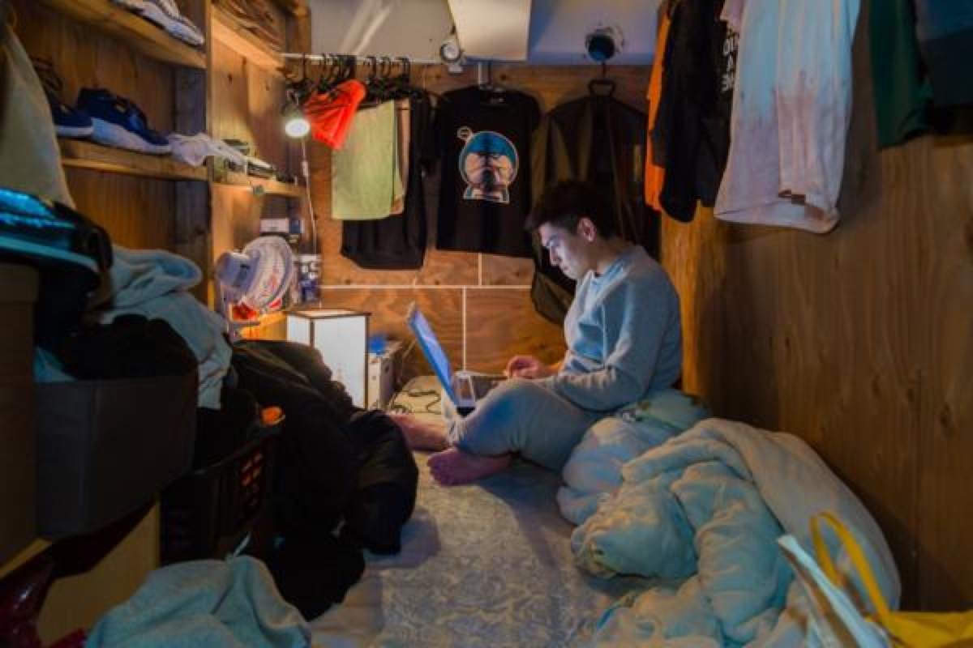
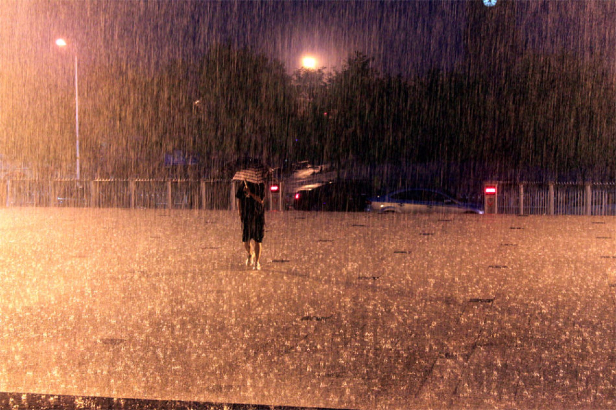
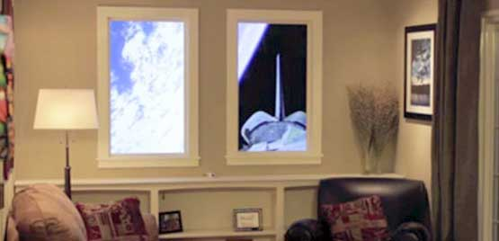

Slide 2

vindow
A window on the wall
World

Slide 3
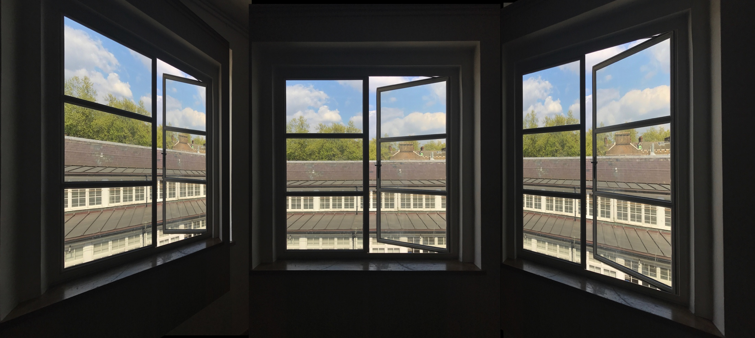
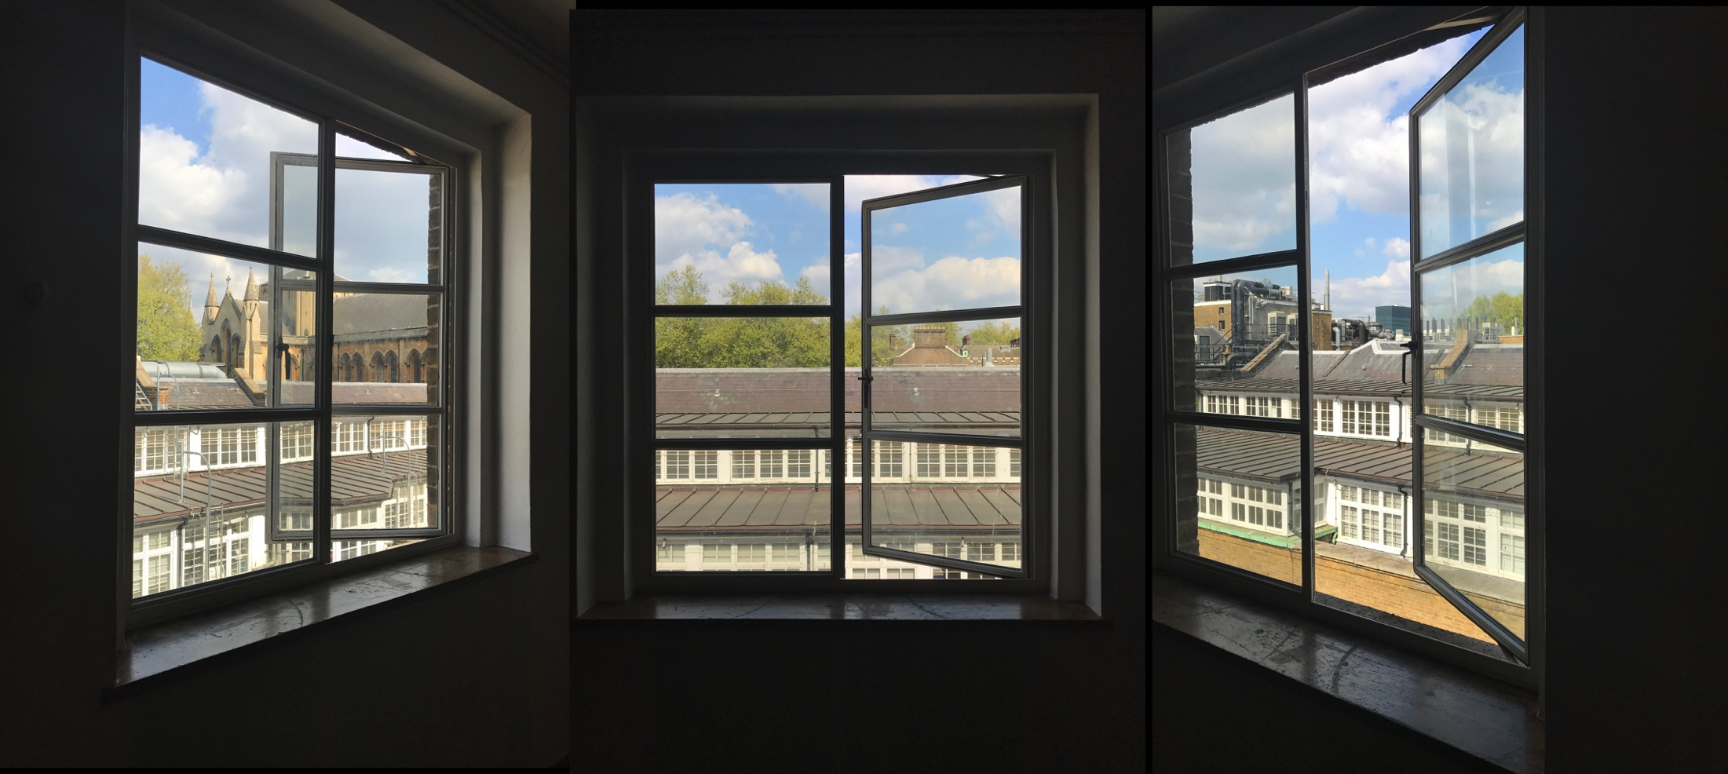

Slide 4
Painting
VINDOW

Slide 5
Painting
demo from winscape
VINDOW

Slide 6
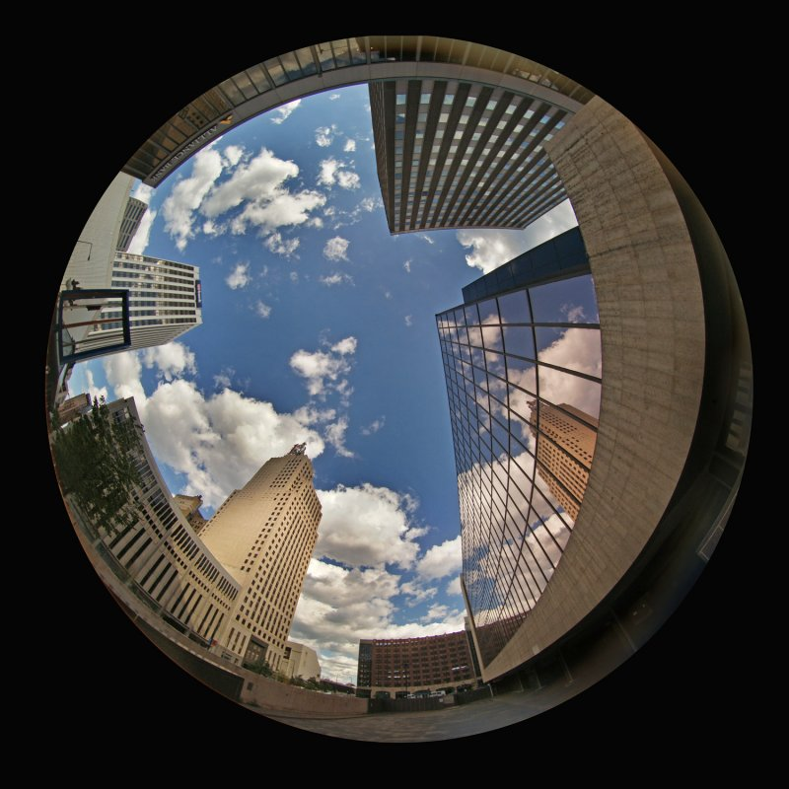
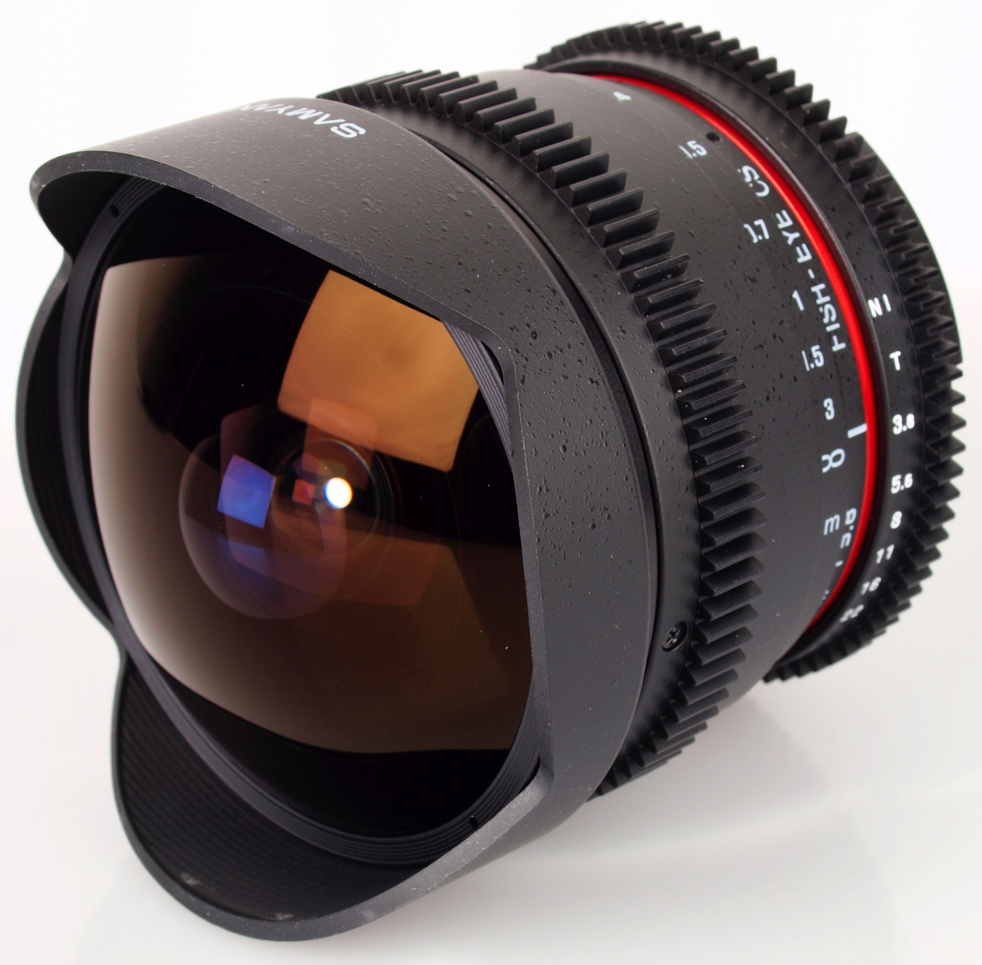
Model Description
Sensor
PC/software
Special Video
Traditional TV/
Smart Television
Camera

Slide 7
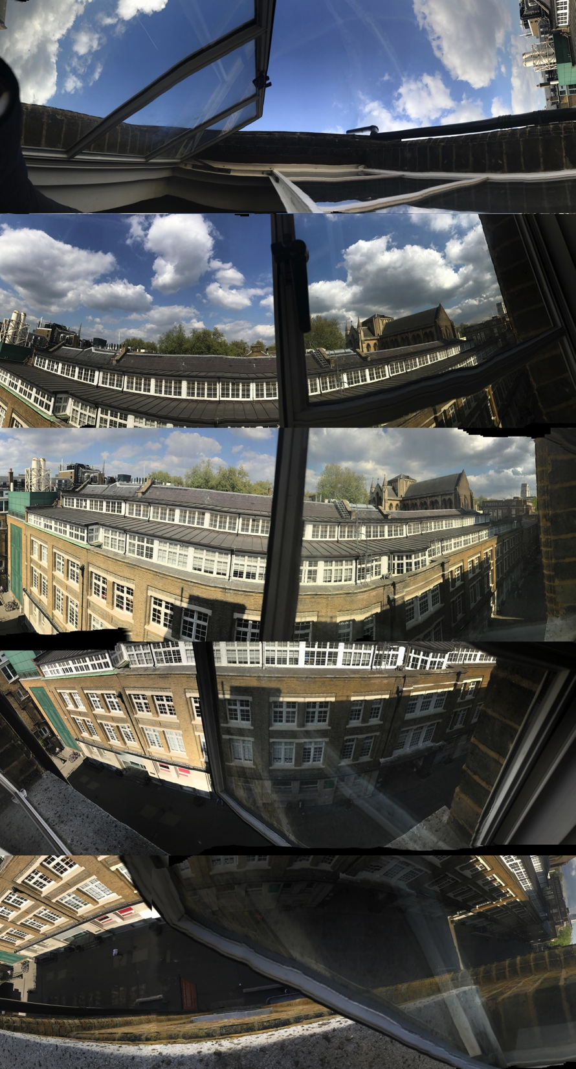
Data collections from five angles per view
https://www.ephotozine.com/article/samyang-8mm-t3-8-asph-if-mc-fisheye-cs-vdslr-review-19835
http://www.dyxum.com/dforum/peleng-8mm-fish_topic49132_page2.html

Slide 8
Model Description
Sensor
PC/software
Special Video
Traditional TV/
Smart Television
Camera

Slide 9
Painting
Vindow
Window

Slide 10
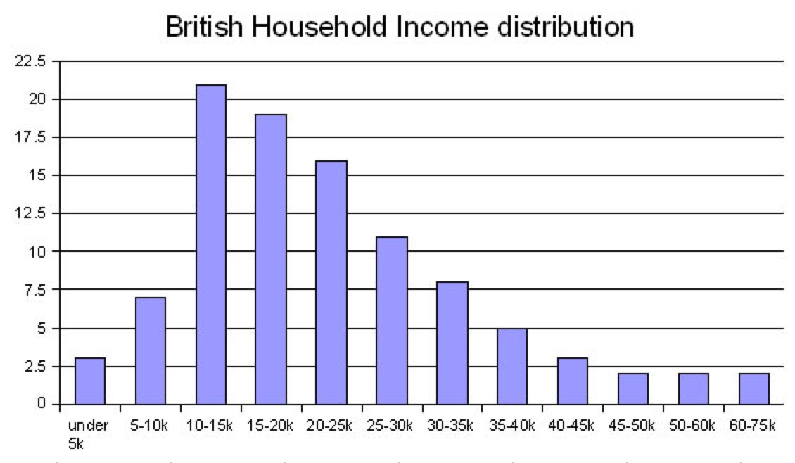
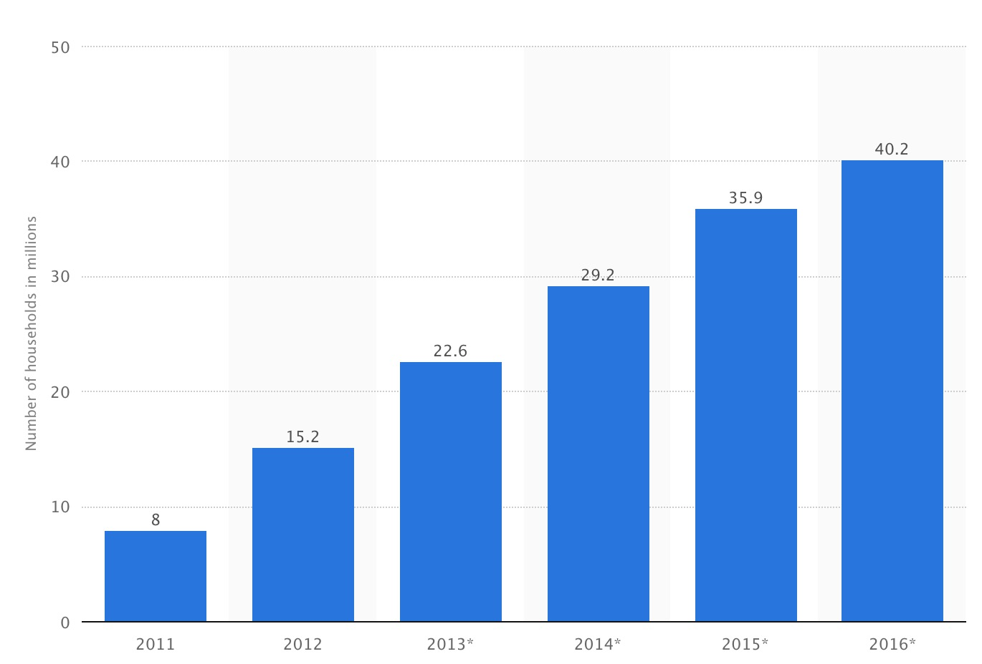
Marketing
Potential Customers (marketing size)
Marketing Growth
https://upload.wikimedia.org/wikipedia/commons/a/a2/British_household_income.jpg
Number of household with smart TV in the U.S.
https://www.statista.com/statistics/268857/number-of-smart-tv-households-in-the-us/

Slide 11
Estimated cost
Objectives | Cost
Product cost | £370
Graphic card + barebone PC | £ 300
Kinetic sensor | £ 15
Camera | £ 54
Software develop | £20,000
Video shooting devices | £10,000
Others (Marketing, IP, administration) | £60,000
Funding required : £100,000

Slide 12
Initial shipment of machines
= £ 70,000 / £ 370
= 189
Net profit
= £ (400-370) * 189
= £ 5675
Number of machines needed
= ( £30,000 / £5675 ) * 189
= 1000 !

Slide 13
SWOT analysis
Strengths | Weaknesses
Extensive applications Easy installation and operation Reasonable price Software protected by copyright | Kinetic sensor is limited to one person Technology dependent Non-essential
Opportunities | Threats
A new emerging market Few competition Reduction in components’ prices | Little constitutive demand Hard to patent to protect IP

Slide 14
Thank you!
And Invest!
Vindow
Zhijun Wang, Zexin Chen,Feng Geng

